Slide 1
Sales & Finance MIS Dashboard – Executive Summary
Excel-based MIS project for management reporting & decision support

Slide 2
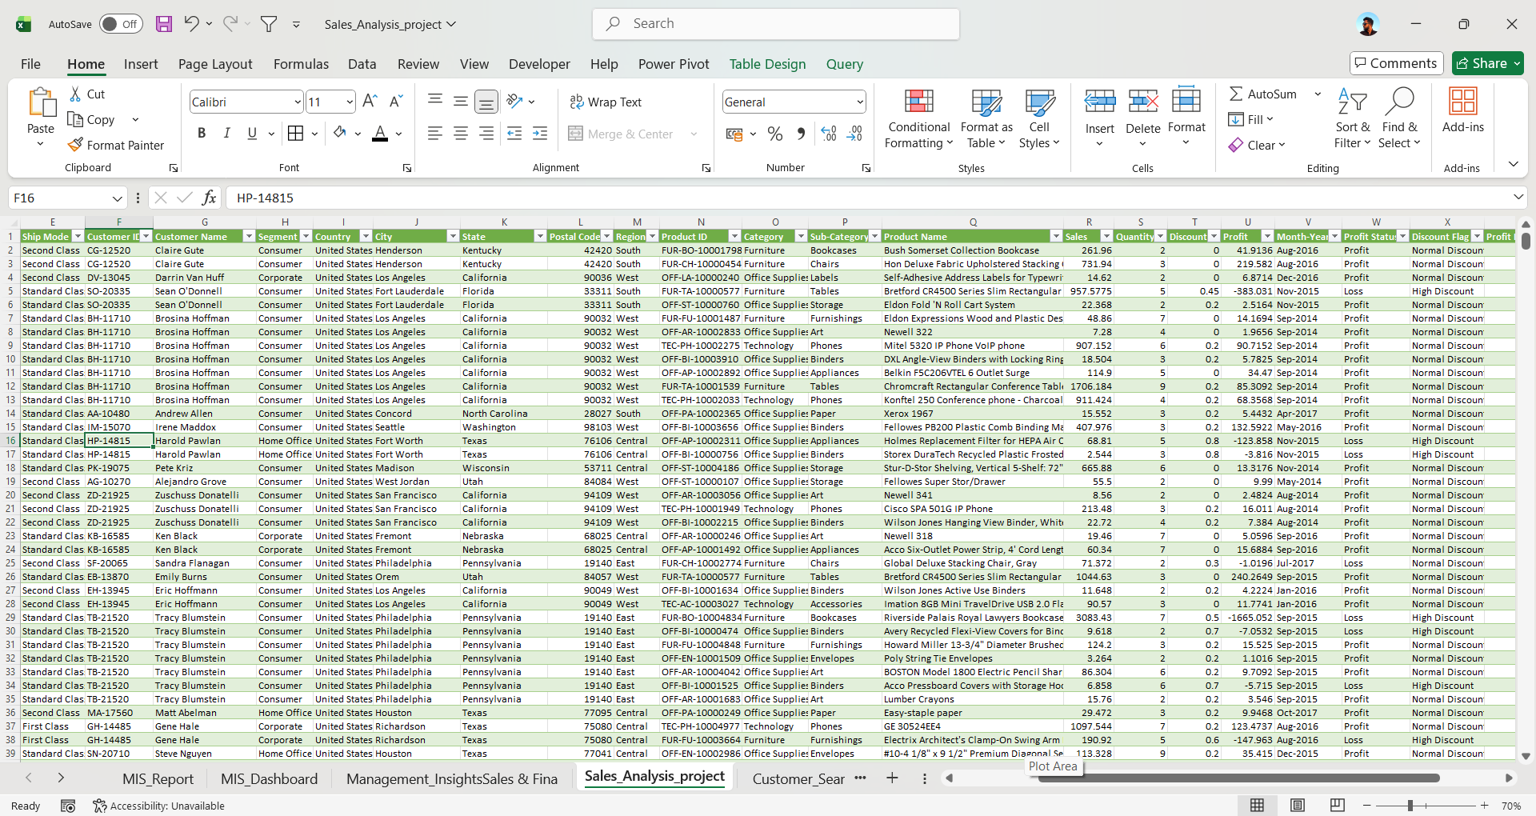
DataSet Sample

Slide 3
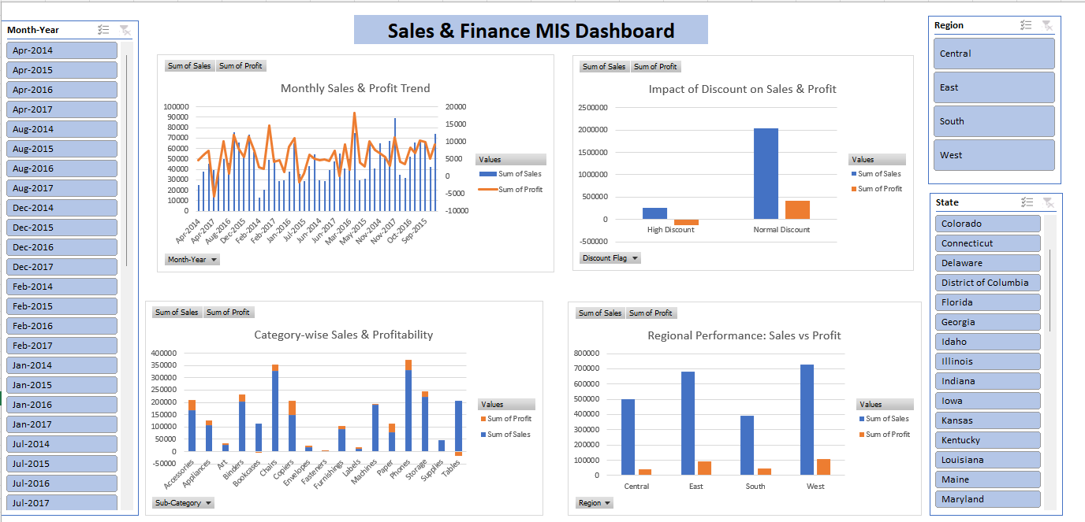
DASHBOARD SNAPSHOT
Monthly Sales vs Profit
Region-wise performance
Category profitability
Discount impact
Slicers (Month, Region)

Slide 4
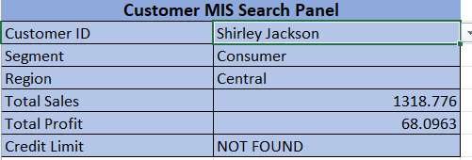
My Role
Built a Customer MIS Search Panel using dropdowns, XLOOKUP, and SUMIFS to instantly retrieve customer-level sales, profit, segment, region, and credit limit.

Slide 5
Key Business Insights
• Sales show an overall upward trend, but profit fluctuates due to margin pressure
• High discounts increase sales volume but reduce overall profitability
• West & East regions contribute maximum revenue and profit
• Certain categories drive profit, while others need margin control
• Monthly profit monitoring is critical, not just sales growth

Slide 6
Tools & Skills Used
Advanced Excel | Power Query | Pivot Tables | XLOOKUP | SUMIFS | MIS Dashboard | Finance Reporting
My Role : Cleaned and transformed data, built finance-focused MIS reports, created interactive dashboard, and summarized insights for management decision-making.

